Slide 1
2021云计算课程 项目答辩
1950072 郑柯凡
1953981 吴昊天

Slide 2
Table of Contents
01
Hadoop介绍
环境搭建
02
03
数据计算
项目演示
04

Slide 3

Hadoop介绍
1
2
Hadoop
HDFS
数据密集型分布式应用
对海量数据进行分布式处理
高容错性
高吞吐量
支持流式传输
3
MapReduce
基于Google MapReduce
适合在分布式的环境中进行数据处理

Slide 4

项目环境搭建
1
使用docker在服务器上配置hadoop环境
2
服务器性能不够，在运行程序时宕机
3
转向在虚拟机上配置

Slide 5
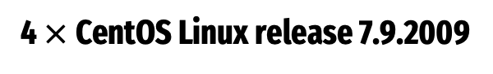
项目环境搭建
4 $×$CentOS Linux release 7.9.2009
Master
Slave1
Slave2
Slave3
192.168.43.220
192.168.43.221
192.168.43.222
192.168.43.223

Slide 6
MapReduce程序本地调试
MapReduce程序在配置好的hadoop服务器上的实际运行测试的过程非常的繁琐
寻找本地调试的方法，可以更快的进行调试运行，
在IDEA中新建一个Java项目，添加相关的maven依赖，完成基本设置
可以在本地运行MapReduce程序，并且进行相关的打包

Slide 7
数据计算及优化
数据计算
在不同的情况生成不同的键值对
统计不同的键值对的数量
数据副本数量
Despite being red, Mars is a cold place
HDFS分块大小
Venus is the second planet from the Sun
增加节点数量
Neptune is the farthest planet from the Sun

Slide 8
项目演示

Slide 9
Isometric Clouds Infographics
Jupiter
1
2
Saturn
Jupiter is the biggest planet
Saturn is the ringed planet
Venus
3
4
Neptune
Venus has a beautiful name
Neptune is the farthest planet

Slide 10
Isometric Clouds Infographics
01
02
03
Neptune
Mercury
Mars
Neptune is the farthest planet from the Sun
Mercury is the closest planet to the Sun
Despite being red, Mars is actually a cold place

Slide 11
Isometric Clouds Infographics
Mercury
Jupiter
1
Mercury is the closest planet to the Sun and the smallest one
Jupiter is a gas giant and the biggest planet in the Solar System
2
Venus
Mars
3
It has a beautiful name and is the second planet from the Sun
Despite being red, it is actually a cold place full of iron oxide dust
4

Slide 12
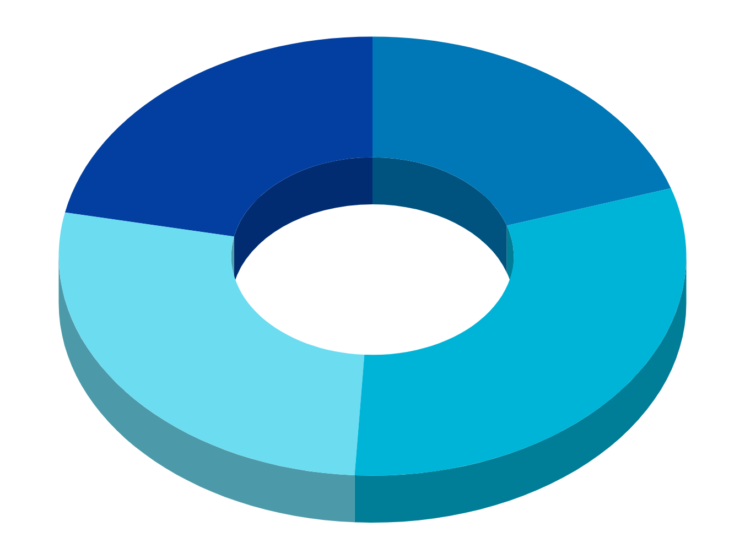
Isometric Clouds Infographics
01
02
Saturn
Mars
It’s composed mostly of hydrogen and helium
Despite being red, Mars is a cold place
03
04
Jupiter
Mercury
The fifth planet from the Sun and the largest one
It is the smallest and innermost planet

Slide 13
Isometric Clouds Infographics
01
02
Mercury
Saturn
Mercury is the closest planet to the Sun and the smallest one
It is the ringed planet. It is composed of hydrogen and helium
03
04
Jupiter
Mars
Jupiter is a gas giant and the biggest object in the Solar System
Despite being red, Mars is actually a very cold place

Slide 14
Isometric Clouds Infographics
Venus
Venus has a beautiful name and is the second planet from the Sun
Mars
Despite being red, Mars is actually a cold place full of iron oxide dust
Mercury
Mercury is the closest planet to the Sun and the smallest one

Slide 15
Isometric Clouds Infographics
60%
75%
Mars
Neptune
Despite being red, Mars is a cold place
It’s a gas giant and the biggest planet
53%
61%
Mercury
Venus
Mercury is the closest planet to the Sun
Venus is the second planet from the Sun

Slide 16
Isometric Clouds Infographics
Jupiter is the biggest planet
1
2
It’s a gas giant and has several rings
Despite being red, Mars is cold
3
4
Mercury is the smallest planet
Venus has a beautiful name
5
6
Neptune is the farthest planet

Slide 17
Isometric Clouds Infographics
Mercury
Venus
Mercury is the closest planet to the Sun
Venus is the second planet from the Sun
Mars
Jupiter
Despite being red, Mars is a cold place
It’s the biggest planet in the Solar System

Slide 18
Isometric Clouds Infographics
Jupiter
Mercury
Jupiter is a gas giant and also the biggest planet
Mercury is the closest planet to the Sun
Mars
Venus
Despite being red, Mars is a cold place
Venus is the second planet from the Sun
Neptune
Earth
Neptune is the farthest planet from the Sun
Earth is the only planet that harbors life

Slide 19
Isometric Clouds Infographics
Mars
Venus
Despite being red, Mars is a cold place. It’s full of iron oxide dust
Venus has a beautiful name and is the second planet from the Sun
Mercury
Jupiter
Mercury is the closest planet to the Sun and the smallest one
Jupiter is a gas giant and the biggest planet in the Solar System

Slide 20
Isometric Clouds Infographics
Mercury
Neptune
Mercury is the closest planet to the Sun and the smallest one in the Solar System
Neptune is the farthest planet from the Sun and also the fourth-largest of them all
Mars
Saturn
Despite being red, Mars is a very cold place. The planet is full of iron oxide dust
Earth is the third planet from the Sun and, apparently, the only one that harbors life

Slide 21
Isometric Clouds Infographics
Mercury
Neptune
Mercury is the closest planet to the Sun and the smallest one in the Solar System
Neptune is the farthest planet from the Sun and also the fourth-largest of them all
Mars
Saturn
Despite being red, Mars is a very cold place. The planet is full of iron oxide dust
Earth is the third planet from the Sun and, apparently, the only one that harbors life

Slide 22
Isometric Clouds Infographics
Mars
Despite being red, Mars is a cold place. The planet is full of iron oxide dust
Saturn
Neptune
Saturn is the ringed one. It’s composed mostly of hydrogen and helium
The reason why Neptune is blue is due to the presence of gas methane

Slide 23

Isometric Clouds Infographics
Jupiter
Saturn
Jupiter is the biggest planet of them all
It’s a gas giant and has several rings
Mars
Neptune
Despite being red, Mars is actually cold
It’s the farthest planet from the Sun
Earth
Mercury
Earth is the third planet from the Sun
It’s the closest planet to the Sun

Slide 24
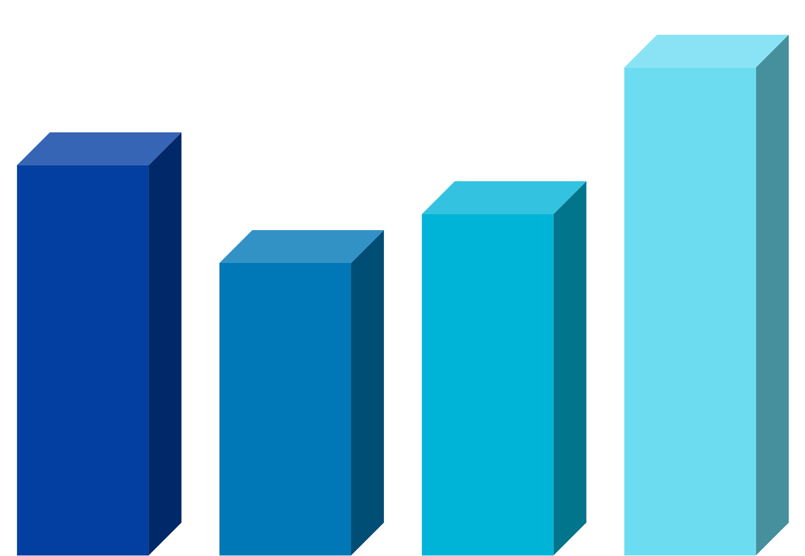
Isometric Clouds Infographics
Jupiter
Saturn
Jupiter is the biggest planet of them all
It’s a gas giant and has several rings
Mars
Neptune
Despite being red, Mars is actually cold
It’s the farthest planet from the Sun

Slide 25
Isometric Clouds Infographics
01
02
Saturn
Mars
It’s composed mostly of hydrogen and helium
Despite being red, Mars is a cold place
03
04
Jupiter
Mercury
The fifth planet from the Sun and the largest one
It is the smallest and innermost planet

Slide 26
Isometric Clouds Infographics
01
Mercury is the closest planet to the Sun
Mercury
02
Venus is the second planet from the Sun
Venus
03
Big Data
Jupiter is a gas giant and the biggest planet
Jupiter
04
Yes, this is the ringed one. It’s a gas giant
Saturn

Slide 27
Isometric Clouds Infographics
Jupiter
Venus
It’s a gas giant and the biggest planet
It’s the second planet from the Sun
Mars
Neptune
Despite being red, it’s a very cold place
This is the farthest planet from the Sun
Mercury
Saturn
It’s the smallest planet of them all
Yes, this is the ringed one and a gas giant

Slide 28
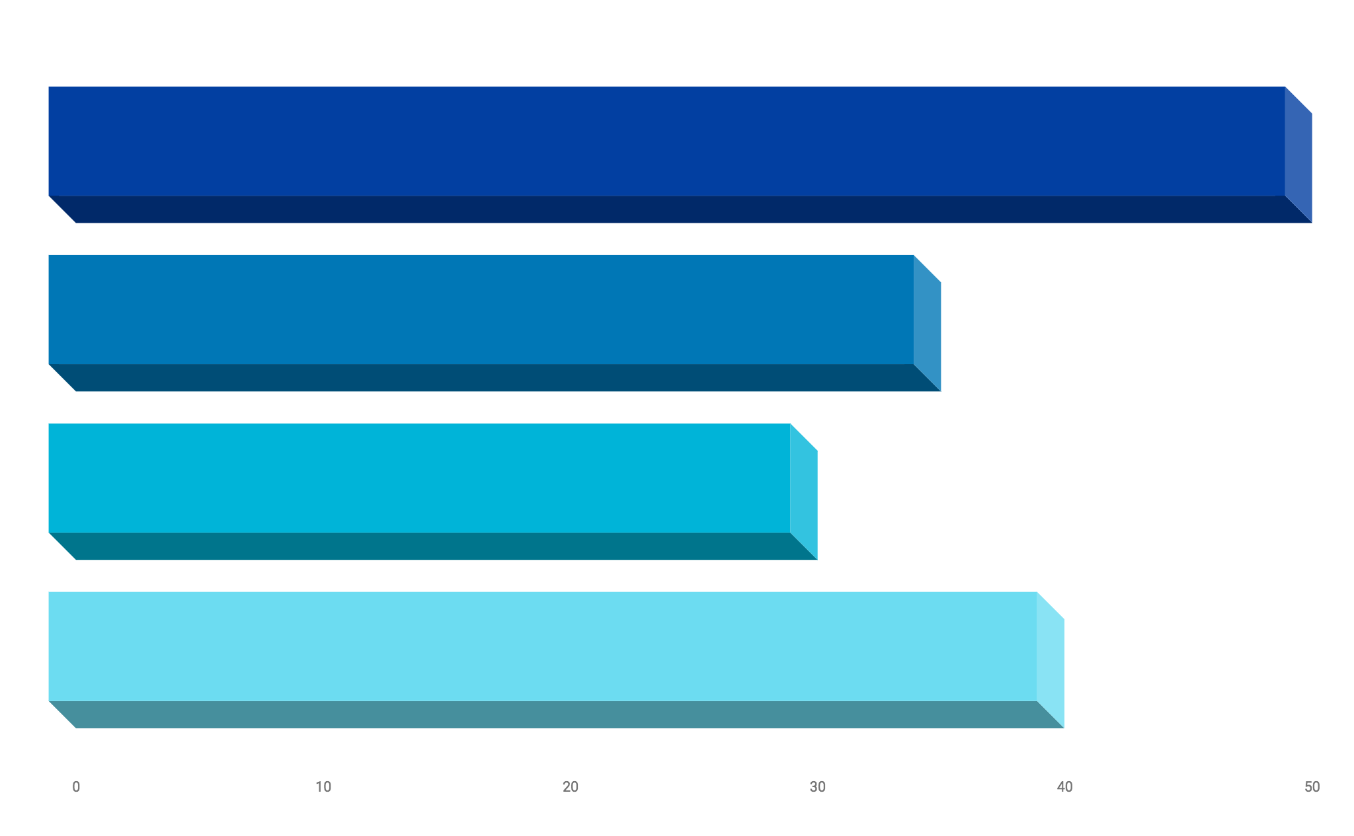
Isometric Clouds Infographics
Jupiter
It’s a gas giant and the biggest planet
Mars
Despite being red, Mars is a cold place
Mercury
It’s the closest planet to the Sun
Saturn
It’s the ringed one and a gas giant

Slide 29
Isometric Clouds Infographics
01
Venus has a beautiful name and is the second one from the Sun
02
Mercury is the closest planet to the Sun and the smallest one
03
Despite being red, Mars is a cold place full of iron oxide dust
Venus
50%
Mercury
70%
04
Mars
70%
Jupiter
40%
It’s a gas giant and the biggest planet in the Solar System

Slide 30
Isometric Clouds Infographics
Mars
Saturn
Despite being red, Mars is a cold place
It’s a gas giant and the biggest planet
Mercury
Venus
Mercury is the closest planet to the Sun
Venus is the second planet from the Sun

Slide 31
Isometric Clouds Infographics
Venus is a planet that has a really beautiful name and is the second planet from the Sun
Mars is a cold desert world. It is half the size of Earth. Mars is sometimes called the Red Planet
Jupiter is the biggest planet in our solar system. It's similar to a star, but it never got big enough
Saturn isn’t the only planet to have rings, but it definitely has the most beautiful ones

Slide 32
Isometric Clouds Infographics
50%
Venus
Venus is the second planet from the Sun
Mars
Despite being red, Mars is a cold place
20%
Mercury
30%
It’s the closest planet to the Sun

Slide 33
Instructions for use (free users)
In order to use this template, you must credit Slidesgo by keeping the Thanks slide.
You are allowed to:
Modify this template.
Use it for both personal and commercial purposes.
You are not allowed to:
Sublicense, sell or rent any of Slidesgo Content (or a modified version of Slidesgo Content).
Distribute this Slidesgo Template (or a modified version of this Slidesgo Template) or include it in a database or in any other product or service that offers downloadable images, icons or presentations that may be subject to distribution or resale.
Use any of the elements that are part of this Slidesgo Template in an isolated and separated way from this Template.
Delete the “Thanks” or “Credits” slide.
Register any of the elements that are part of this template as a trademark or logo, or register it as a work in an intellectual property registry or similar.
For more information about editing slides, please read our FAQs or visit Slidesgo School:
https://slidesgo.com/faqs and https://slidesgo.com/slidesgo-school

Slide 34
Instructions for use (premium users)
In order to use this template, you must be a Premium user on Slidesgo.
You are allowed to:
Modify this template.
Use it for both personal and commercial purposes.
Hide or delete the “Thanks” slide and the mention to Slidesgo in the credits.
Share this template in an editable format with people who are not part of your team.
You are not allowed to:
Sublicense, sell or rent this Slidesgo Template (or a modified version of this Slidesgo Template).
Distribute this Slidesgo Template (or a modified version of this Slidesgo Template) or include it in a database or in any other product or service that offers downloadable images, icons or presentations that may be subject to distribution or resale.
Use any of the elements that are part of this Slidesgo Template in an isolated and separated way from this Template.
Register any of the elements that are part of this template as a trademark or logo, or register it as a work in an intellectual property registry or similar.
For more information about editing slides, please read our FAQs or visit Slidesgo School:
https://slidesgo.com/faqs and https://slidesgo.com/slidesgo-school

Slide 35
Infographics
You can add and edit some infographics to your presentation to present your data in a visual way.
Choose your favourite infographic and insert it in your presentation using Ctrl C + Ctrl V or Cmd C + Cmd V in Mac.
Select one of the parts and ungroup it by right-clicking and choosing “Ungroup”.
Change the color by clicking on the paint bucket.
Then resize the element by clicking and dragging one of the square-shaped points of its bounding box (the cursor should look like a double-headed arrow). Remember to hold Shift while dragging to keep the proportions.
Group the elements again by selecting them, right-clicking and choosing “Group”.
Repeat the steps above with the other parts and when you’re done editing, copy the end result and paste it into your presentation.
Remember to choose the “Keep source formatting” option so that it keeps the design. For more info, please visit Slidesgo School.

